Slide 1

ENSE 471, Project Delivery
[Guardians]
[Xia Hua , Ali Husain, Jiwoun Kim,]
[2020-04-09]

Slide 2
Team (re)introductions
Code Head :Jiwoun Kim
Design Head:Xia Hua
Documentation :Ali Husain

Slide 3
Problem & Requirements
The fire-safety public education program by Regina Fire and Protective Services (RFPS) for elementary school has become obsolete and needed some update or change in order to cope up with the current technology and communication tools, such as line phone training system.

Slide 4
Rationale
Whenever a fire happens, it is disastrous to the community and to the people. The most important part of it is survival especially for the children who are capable to learn surviving techniques. Teaching them to learn essential survival skills in case of fire will enable them to respond appropriately in a fire emergency.

Slide 5
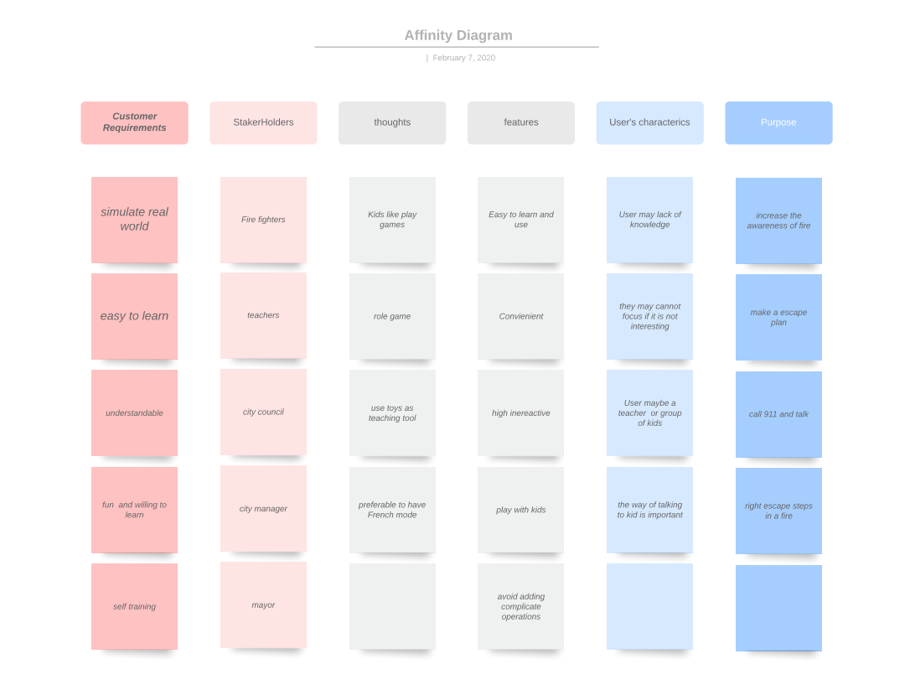

Slide 6
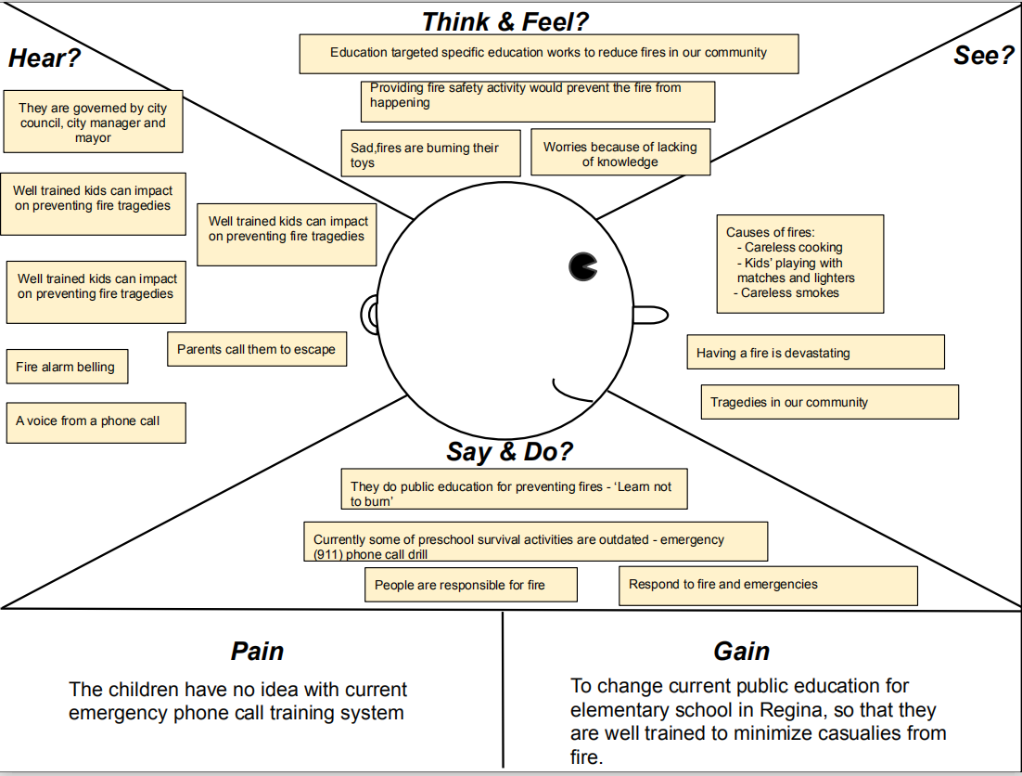

Slide 7
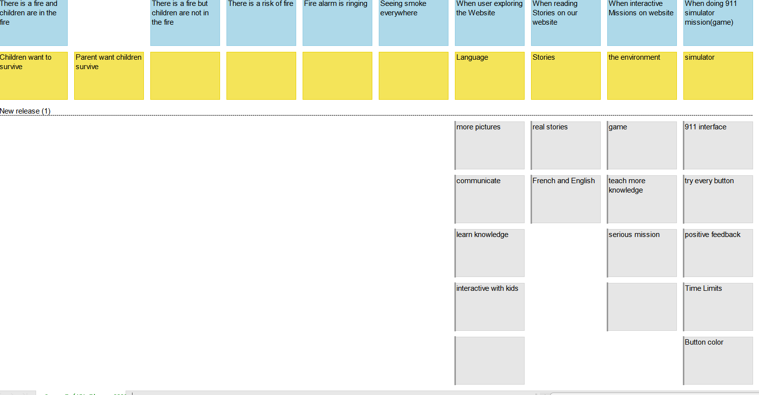
USM

Slide 8
MVP vision
Designing an interactive application for early child, which teaches them to learn various surviving skills in case of fire, such as calling 911, getting away from smoke, evacuating the place and other escape procedures for their survival.

Slide 9

Brainstorming
Ali’s Idea(s):
- It should provide instructions of various operations for e.g. how to report fire by going under which specific menu etc
- Could provide a variety of videos like how to prepare yourself in advance and and other evacuating techniques in case of fire
- Can have an option like “Deaf Emergency” for kids who are deaf or cannot speak
- A game related to fire causing incidents (which provides scenarios of what to do in case of fire) inside the app could also be a good idea in educating the children about fire safety or escape procedure.
Jiwoun’s Idea(s): - The interface should simulate a phone screen on a smartphone. Also, it should represent both iphone or android phone screen.
- Under or top of the screen somewhere, the procedure of the training is to be shown.
- English/French selection - Scenario mode(automatically begins the procedure with guide to show the whole process)
- Try mode with arrows on the phone buttons; what button should be pushed(on phone screen)
- Using real 911 dispatch voices as the training .
Xia’s Idea(s): - A handbook of guidering kids on how to escape and right things to do in a fire or daily life. Using the from of a story book
- A place for parents and other adults to communicate so they can get experience from others
- More picture and sounds less words , so that kids can focus
- Make games or missions more realistic .
- Using more symbols which kids are familiar with, such as cartoon characters , toys…
- Guiding Videos. - Interactive game : Show a picture of a certain circumstance and let players choose the right answer from multiple choice.

Slide 10
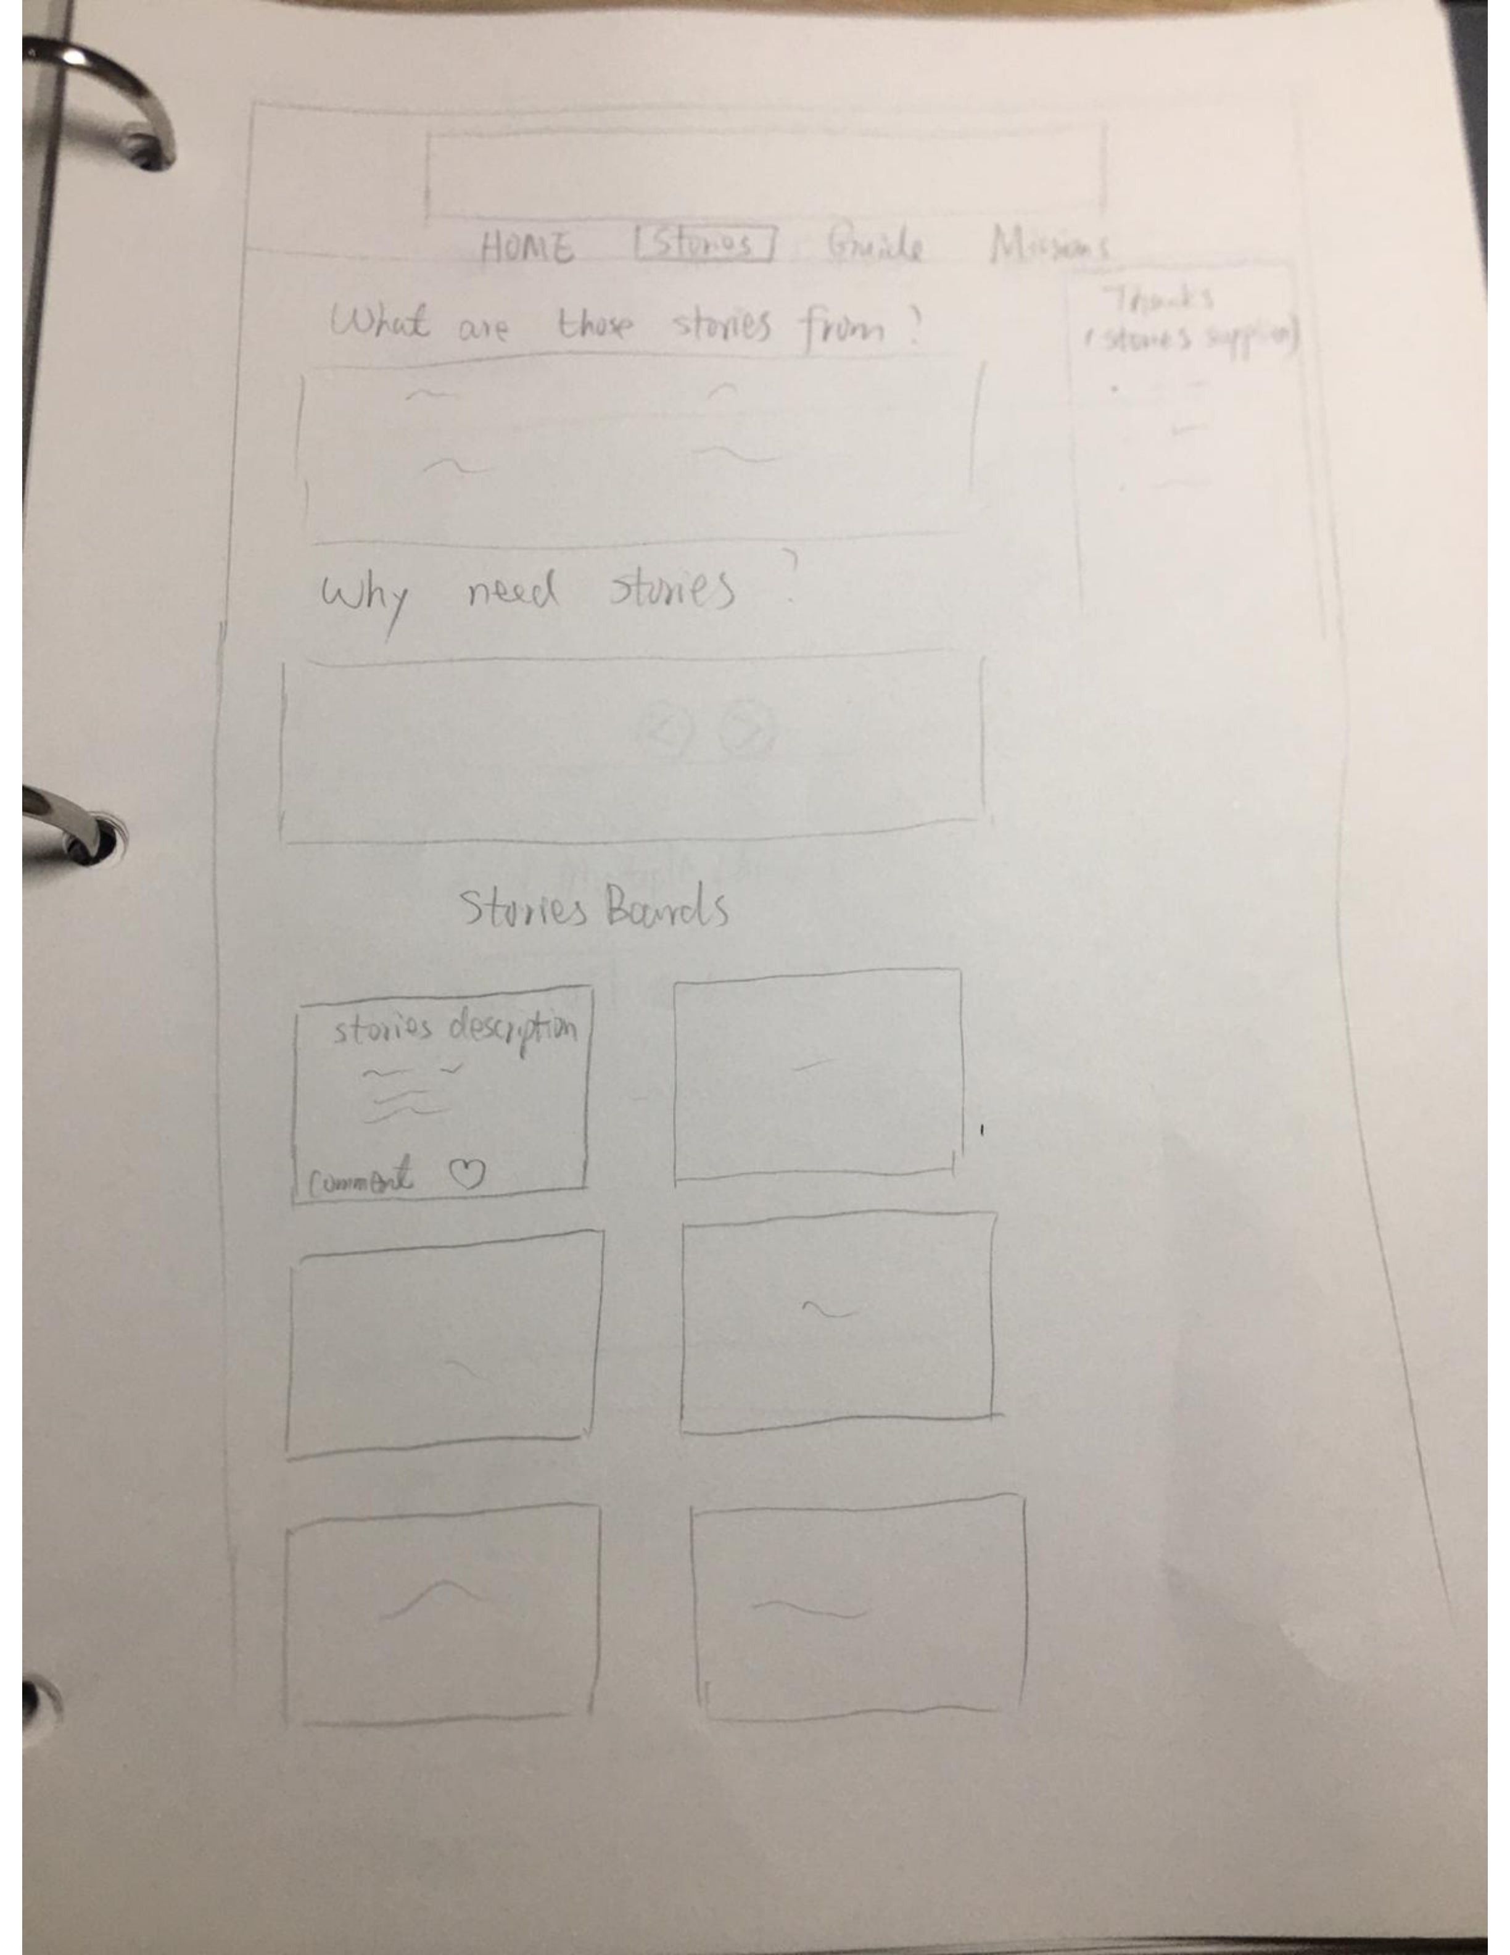
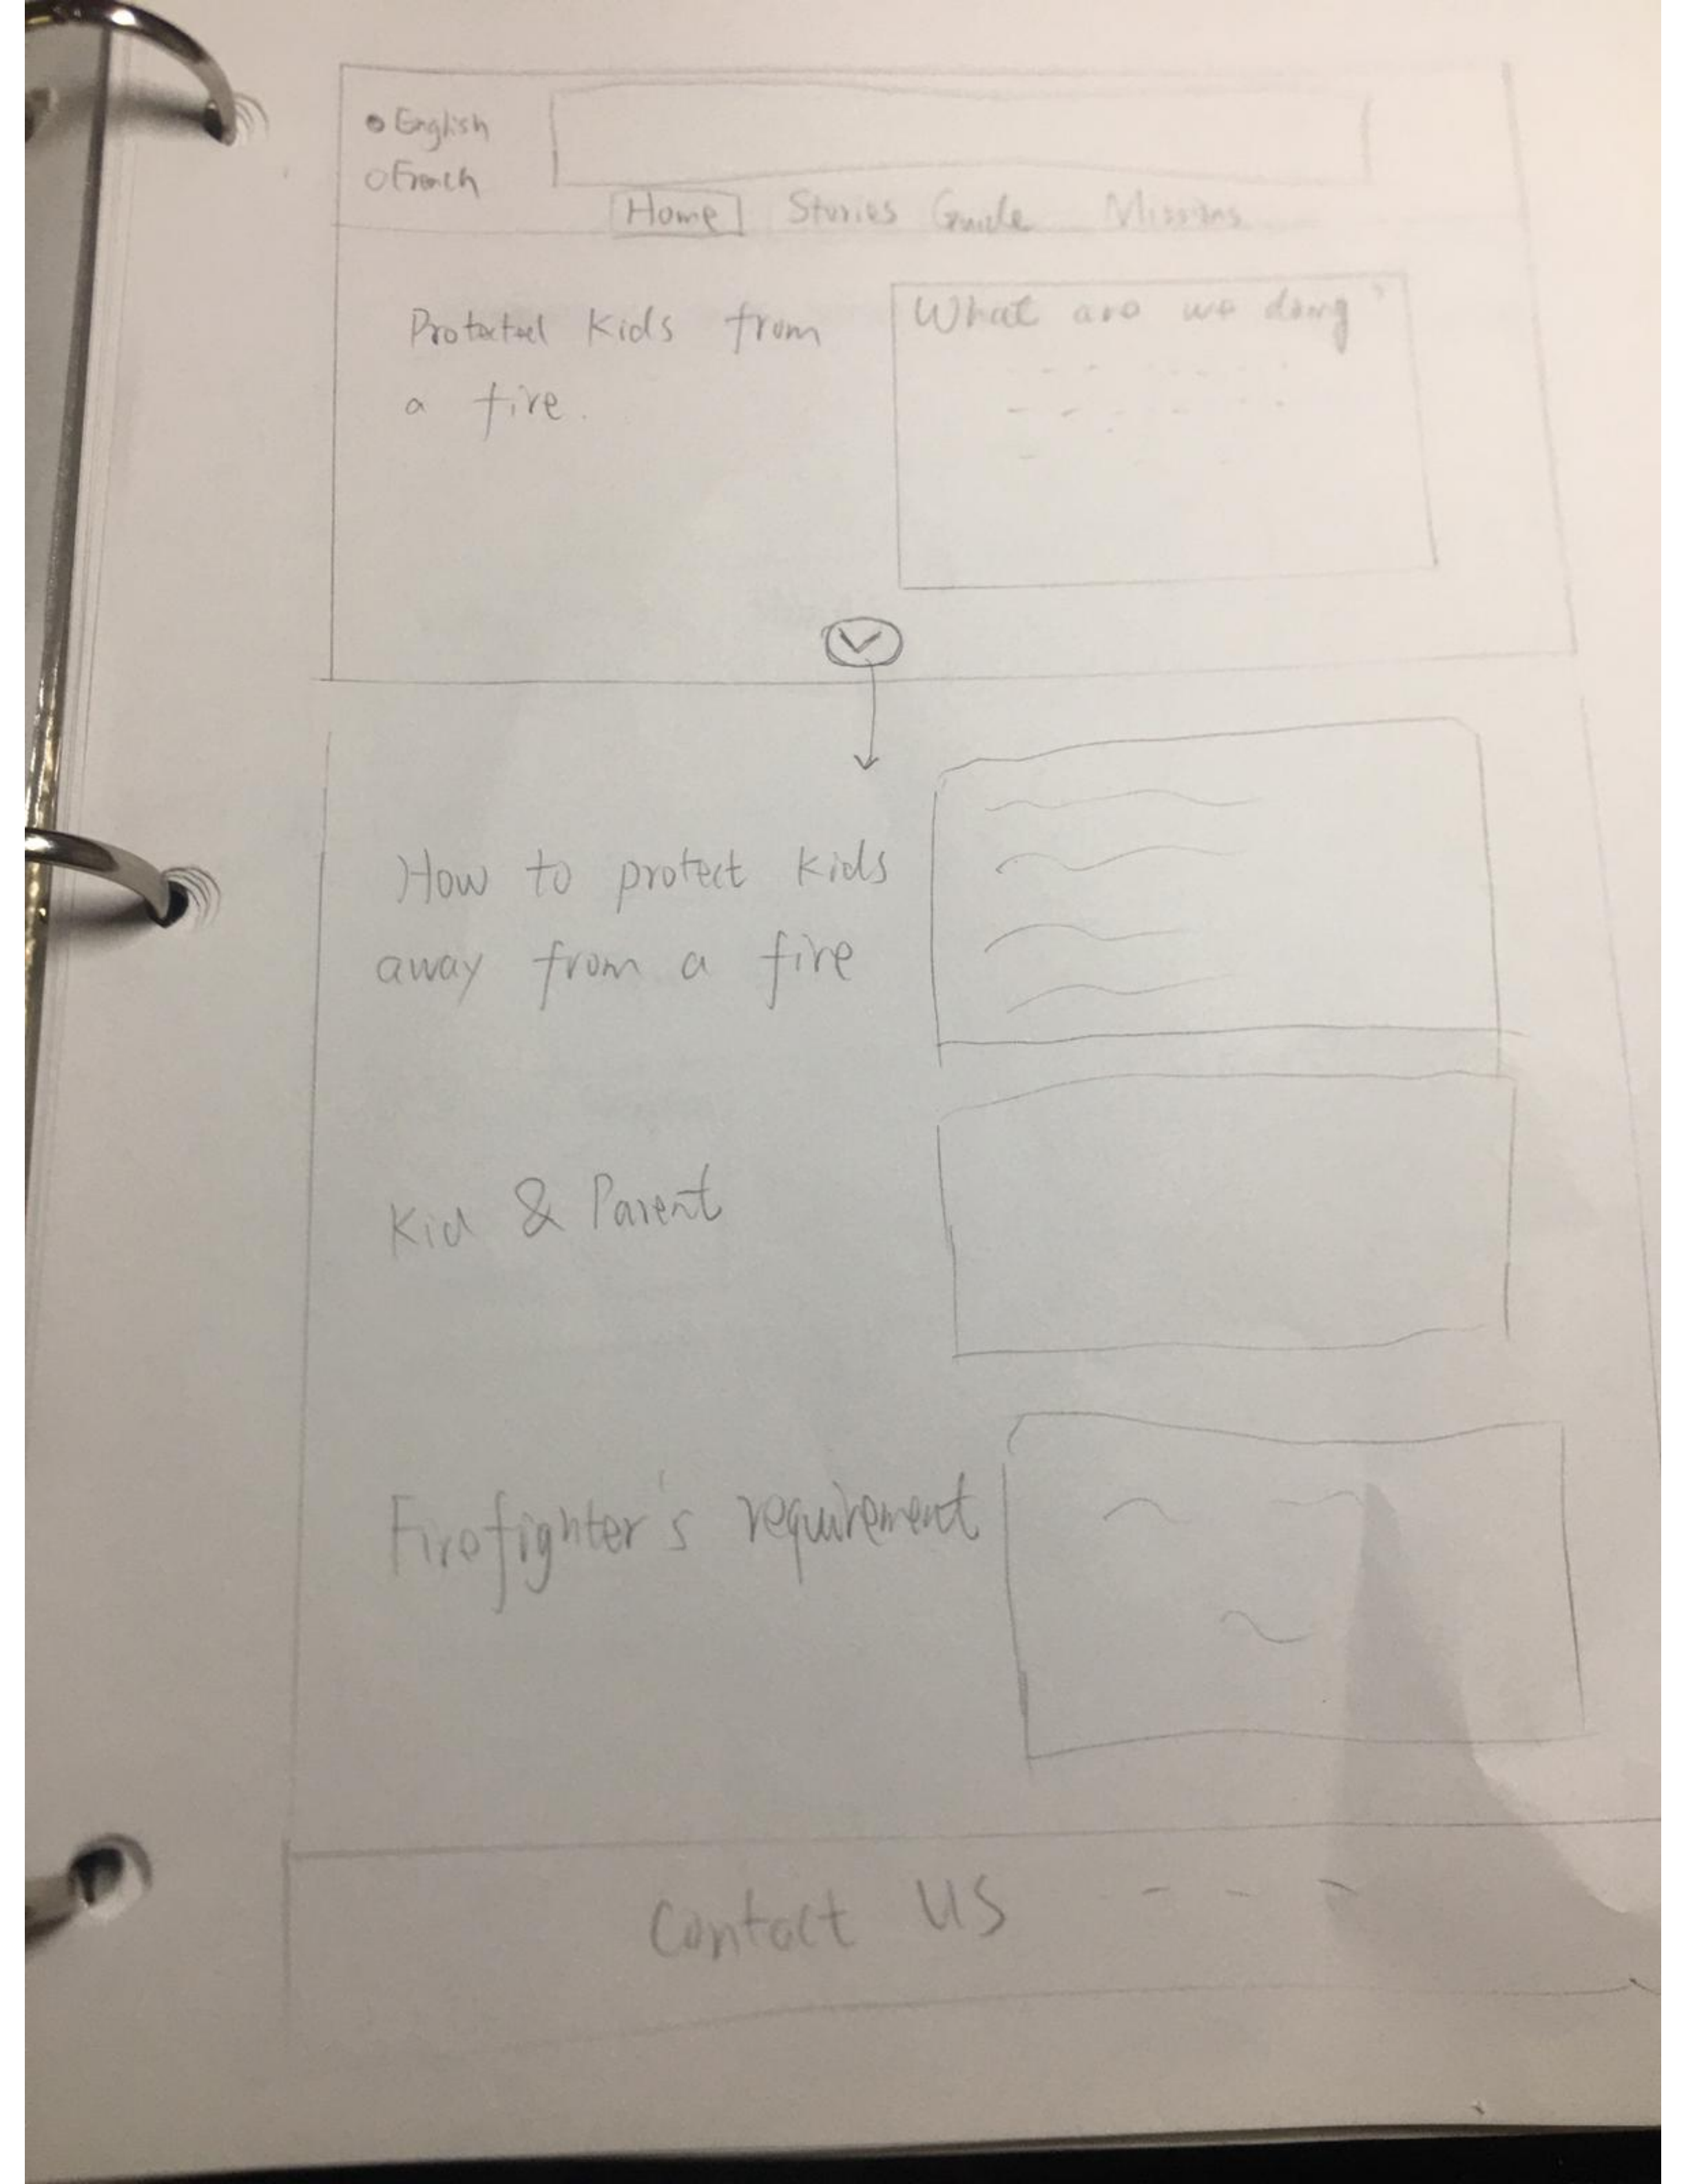
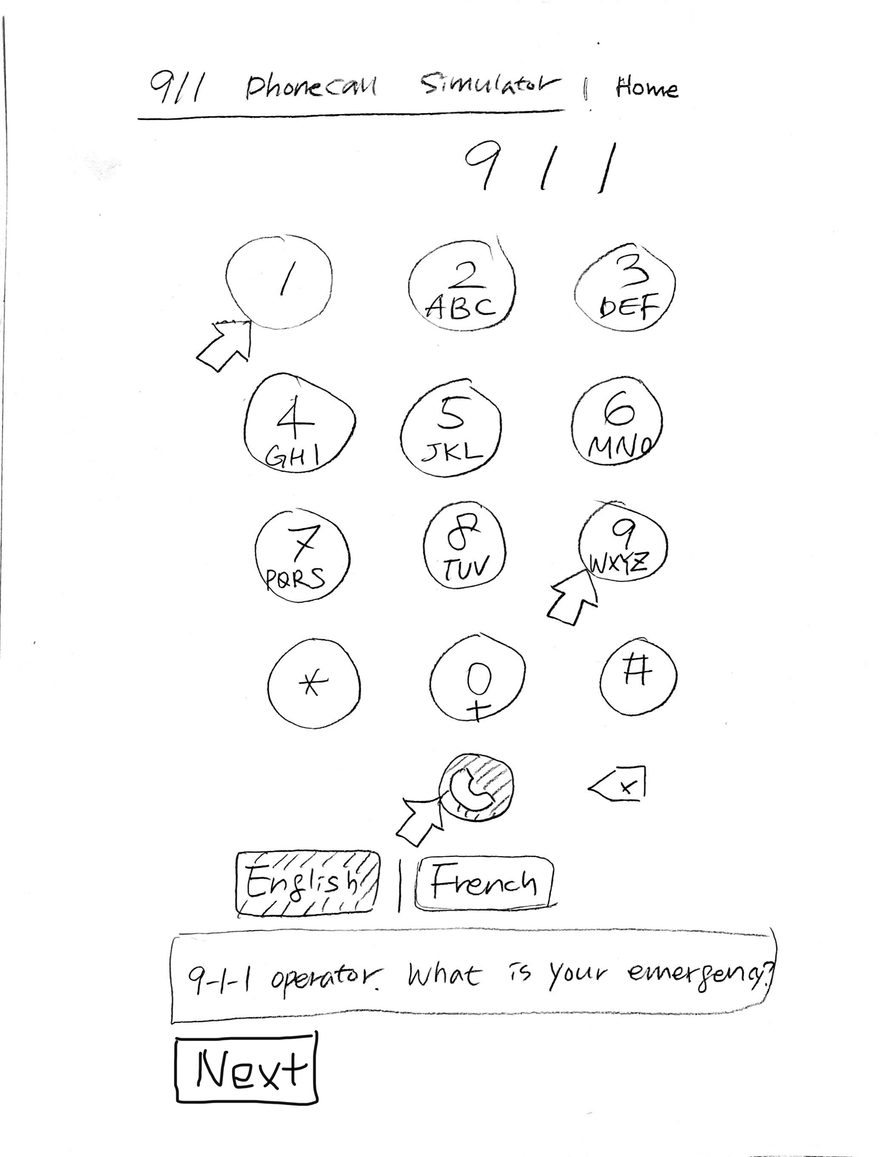
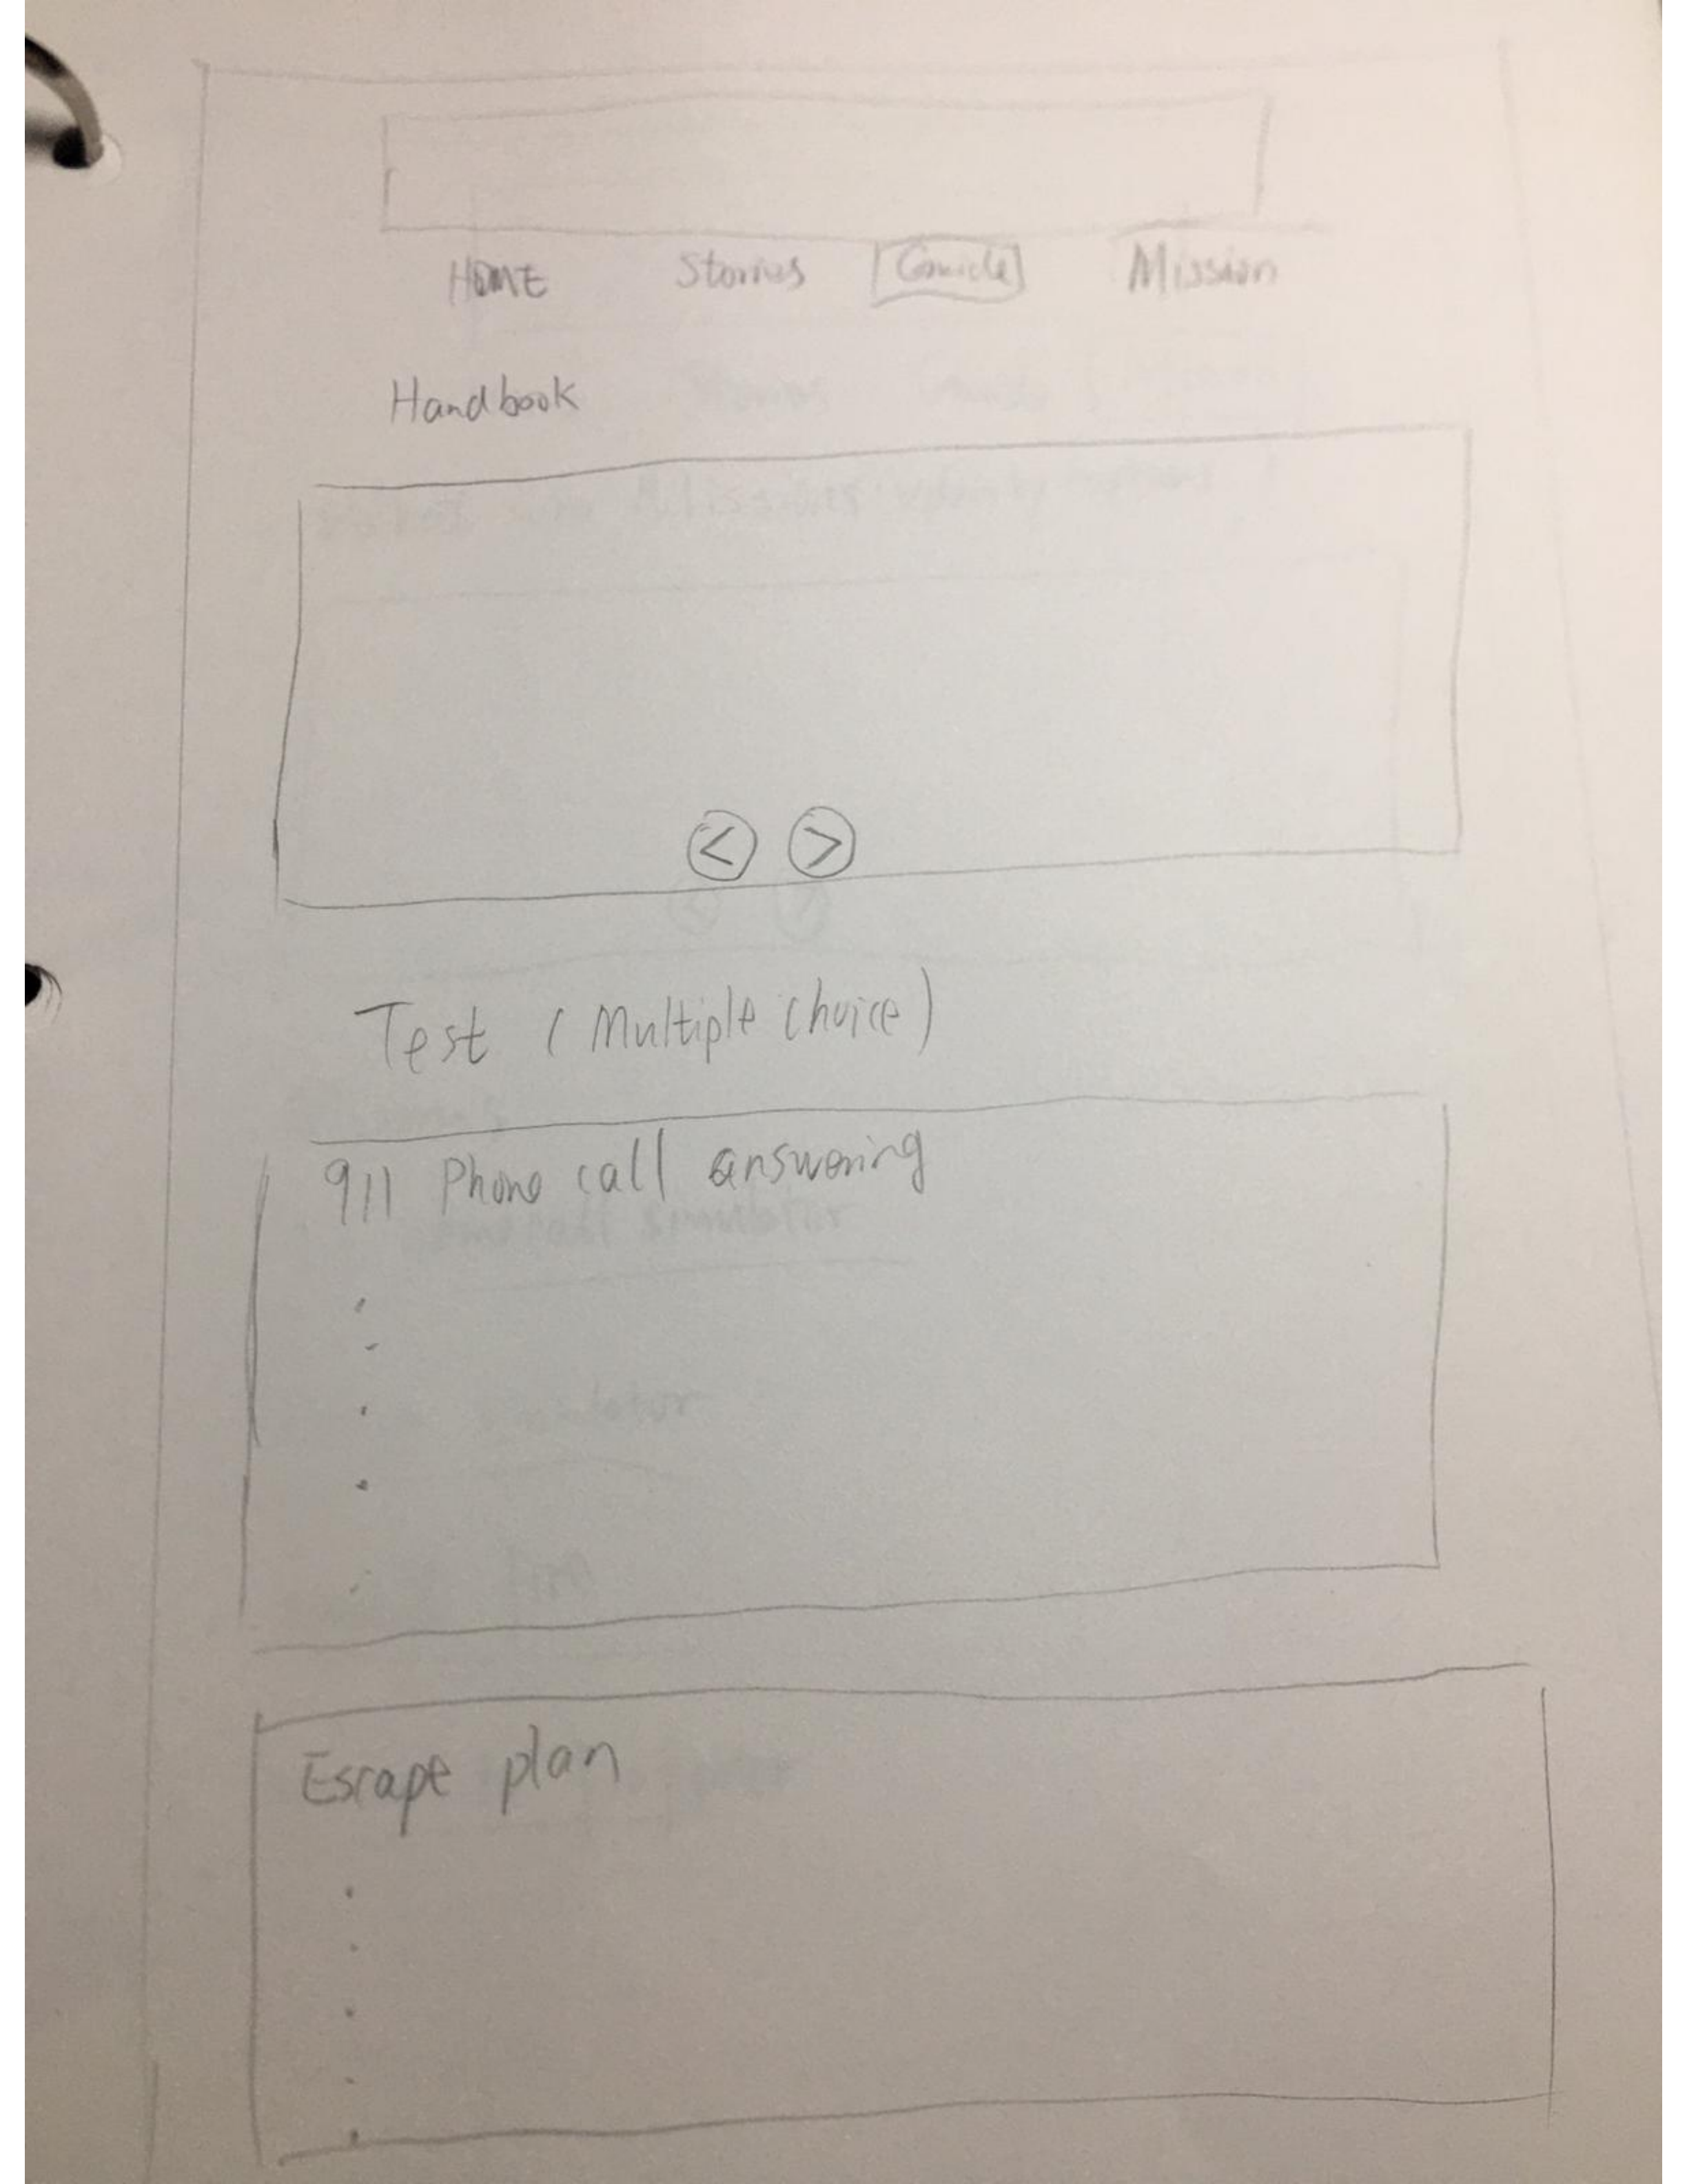
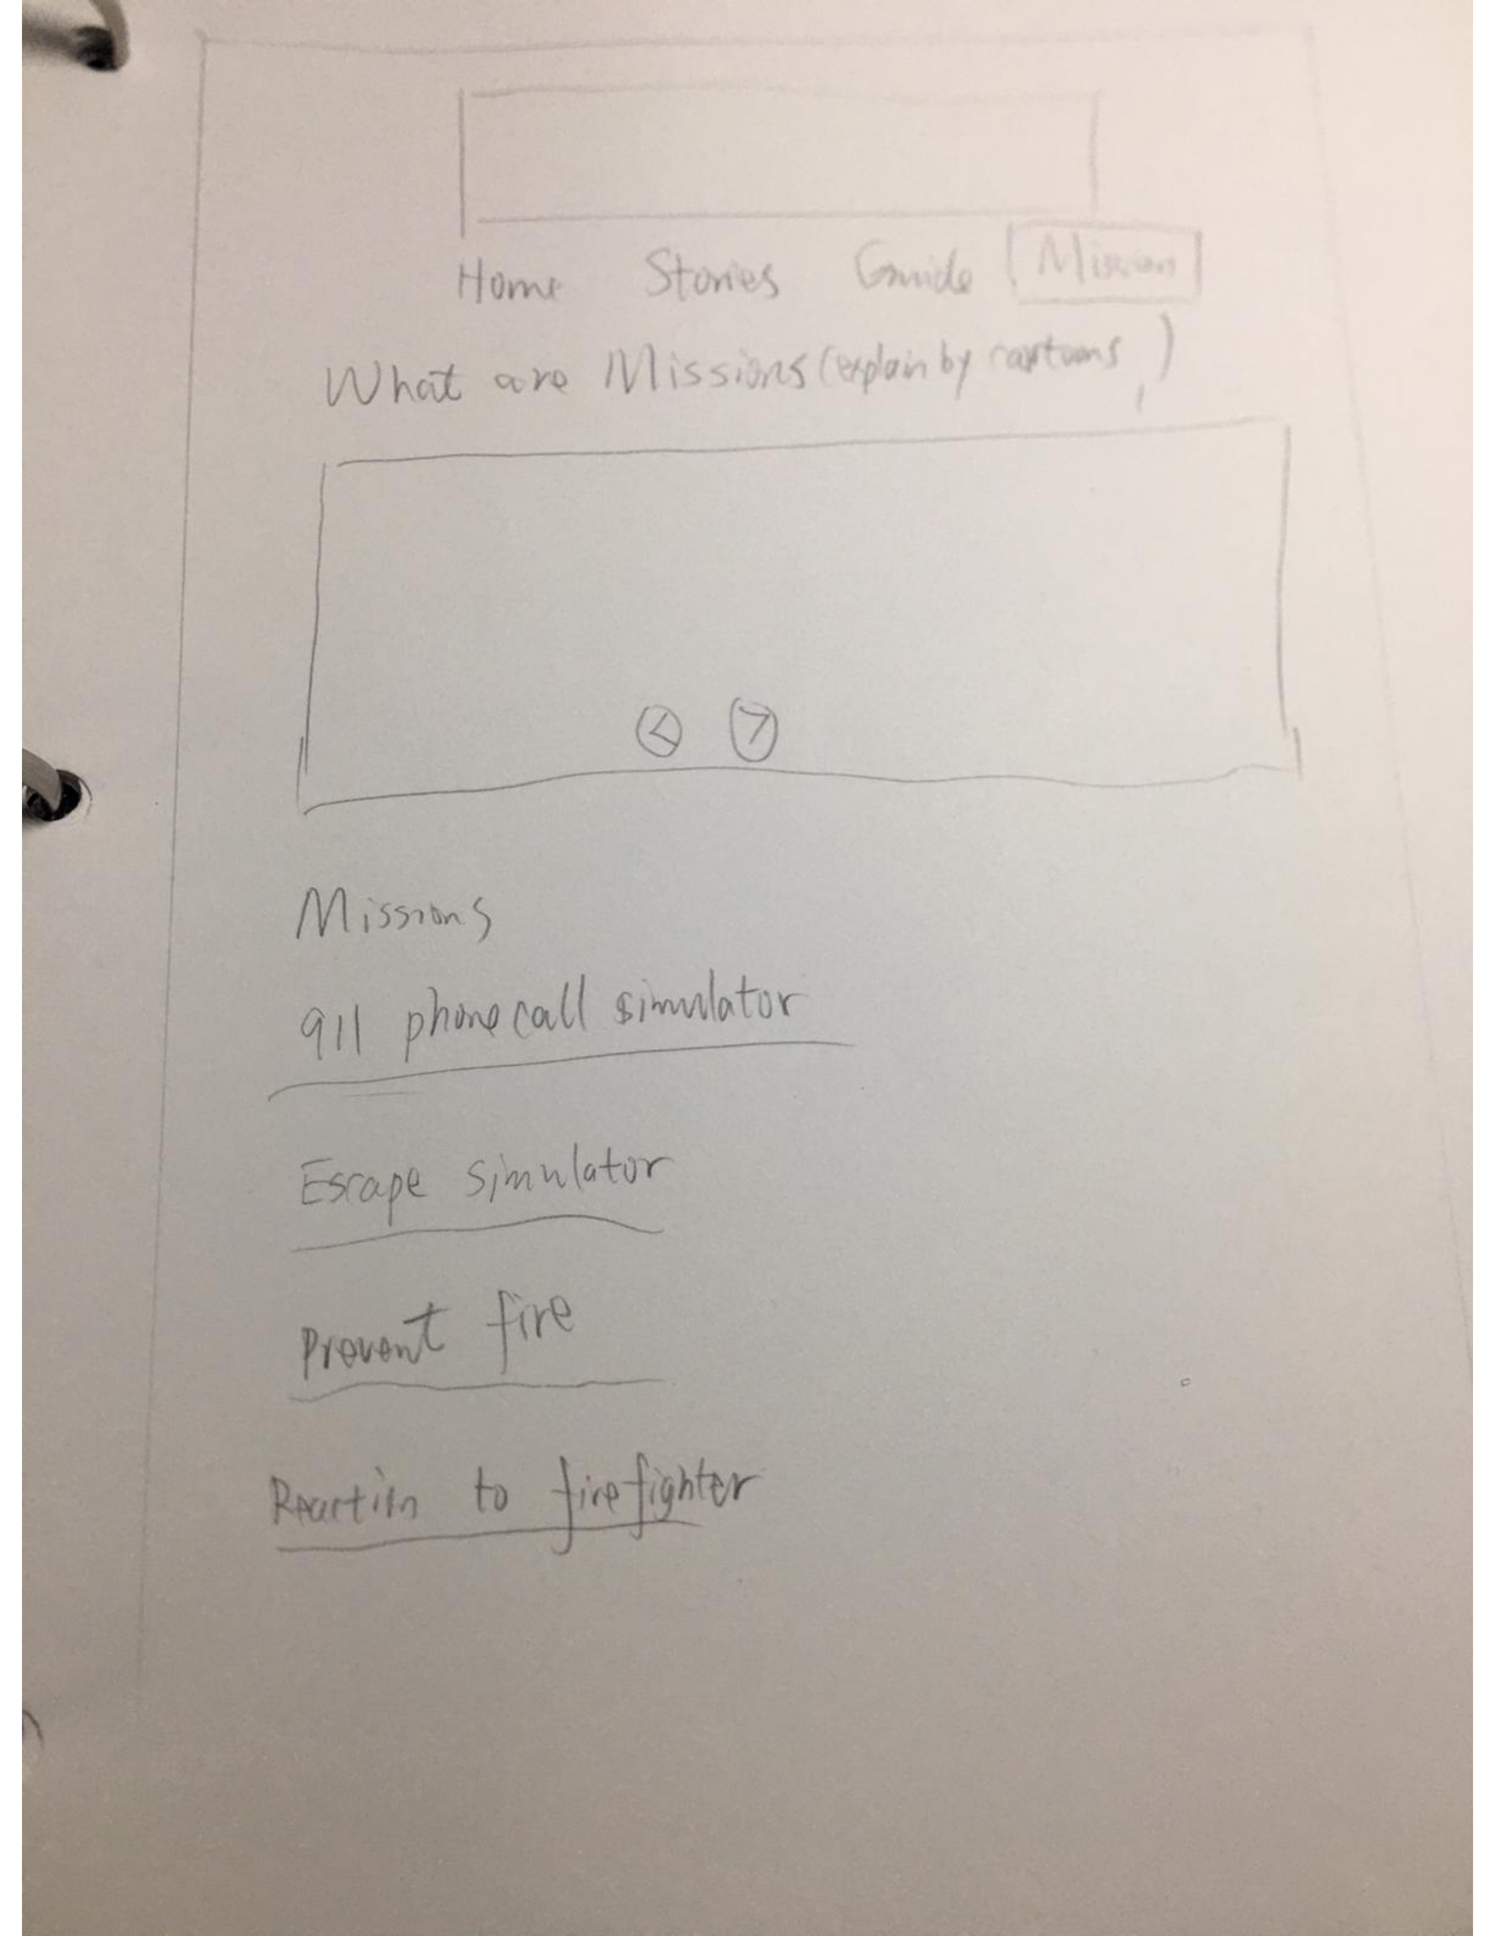
lo-fidelity prototypes

Slide 11
Hi-fidelity prototypes

Slide 12
Principles
1.Affordances: The simulated buttons of iphone and the response are affordance for the child to know that happened and also the voice response that we simulate the 911 phone call.
2.Signifiers: In the phone-simulation, once you are inside the emergency call, the displaying of the number keys are signifiers as they provide signals on how to call 911.Only the right order number exactly 911, and press the call button, the user can get the right response which is calling 911.
3.Constraints: One possible constraint could be the phone system constraint , there are lots different interface of making a phone call in different phone or systems, we can only make our simulate as clear as possible so that can be general.

Slide 13
Solution demo
Do a high-level overview of your solution, including screenshots of key experiences
Demo your solution
Discuss links to lo/hi-fidelity prototypes
Discuss experiences as they relate to your team’s USM/MVP
Again, ensure you link your design ideas back to a minimum of three topics discussed in class relating to people centered design (affordances, gestalt, constraints, etc.)

Slide 14
GitHub “stamp of approval”
Confirm that your team’s GitHub is up to date and user friendly (highly readable and understandable – see the Project Description and Key Deliverables document in URCourses)
NOTE: No need to spend to much time here – do a quick overview and provide your stamp of approval

Slide 15
Group reflection
How did you feel about this project? What did you like about it? What did you dislike?
[Response here]
What did you learn about yourself as you collaborated and worked through this project?
[Response here]
How will you use what you have learned on this project going forward?
[Response here]

